Slide 1

University Hospital
Campus Plan
Community Engagement + Campus Plan
February 21, 2023

Slide 2
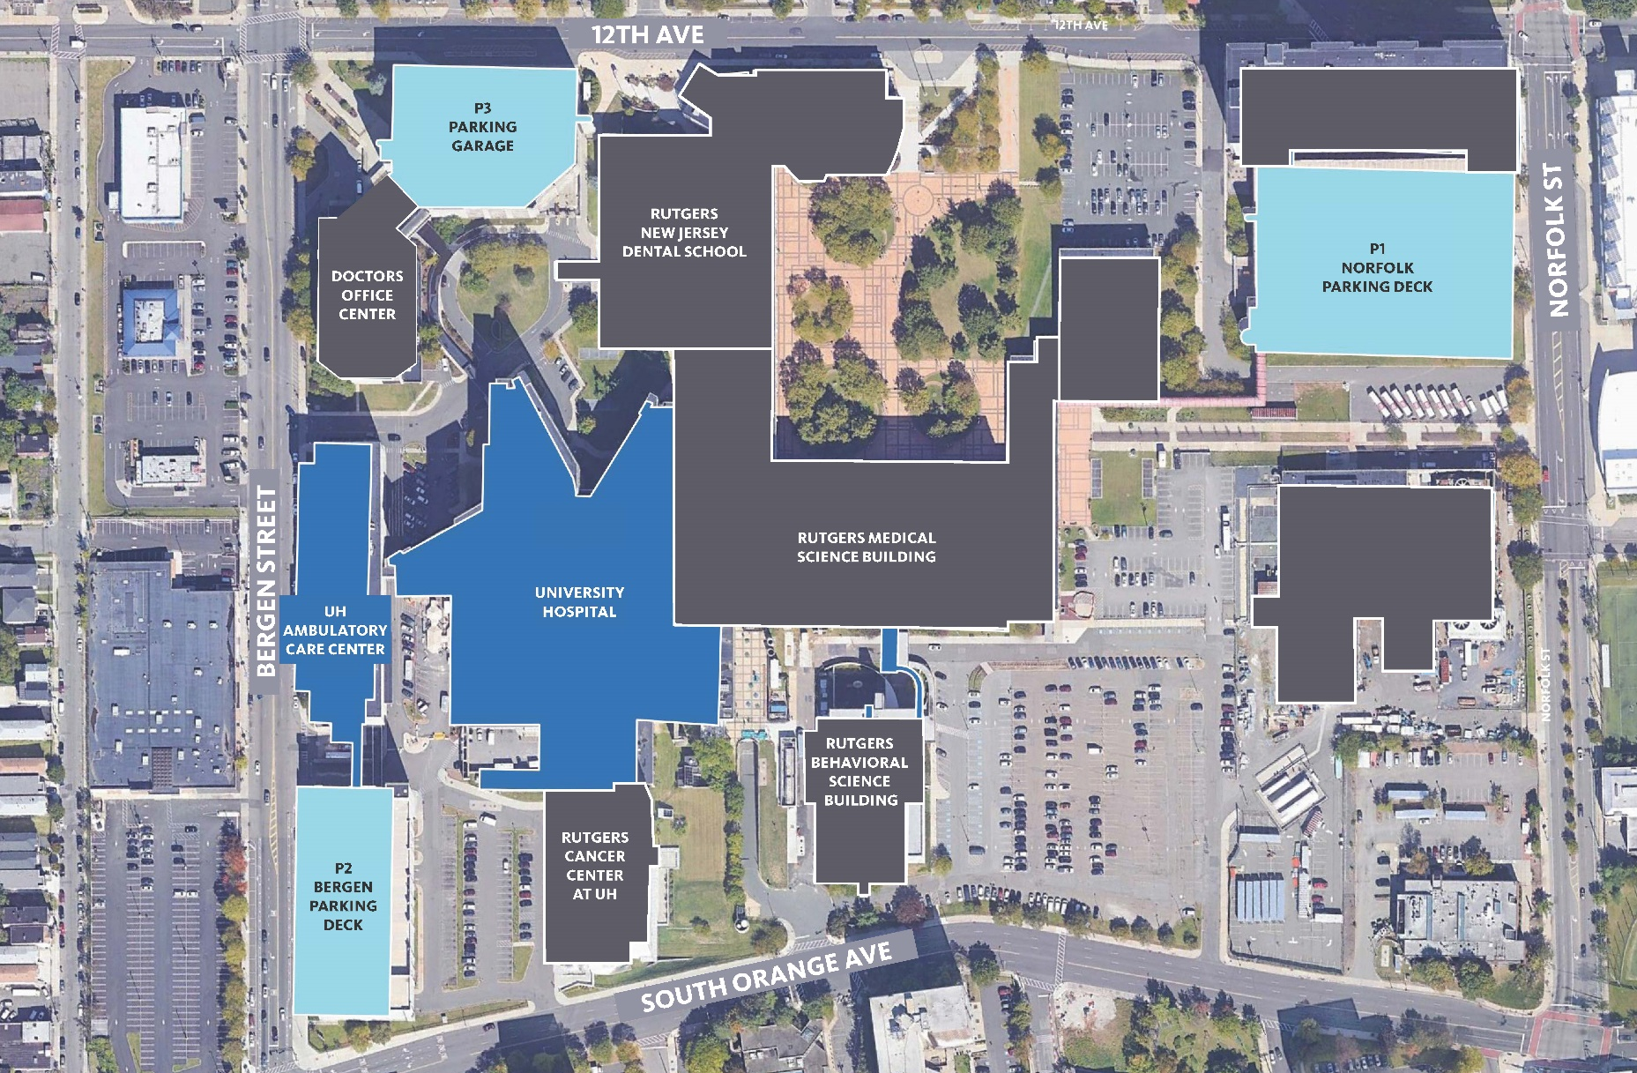
University Hospital Campus Plan
Existing Site Plan

Slide 3
University Hospital Campus Plan | Who We Heard From
Who We Heard From
Over 500 members of the University Hospital community shared their voices through multiple engagement channels
small group conversations | leave-behind posters | muti-lingual digital survey
+300
Community
Voices
Community – Informed
Design Solution
+200
Employee Voices

Slide 4
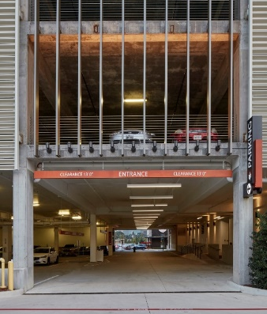
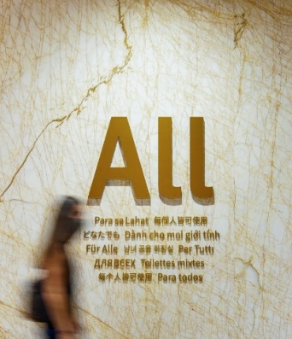
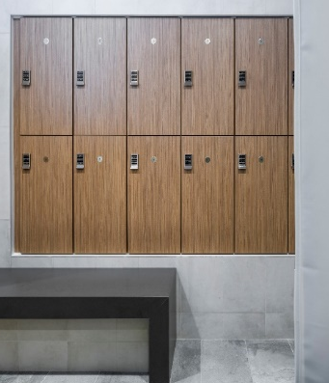
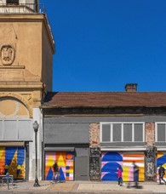





University Hospital Campus Plan | What We Heard
The new University Hospital should …
Foster a Sense of Safety & Trust
^{Build Community & Opportunity}
Create Conditions for Health & Well-being
^{Safe & accessible parking}
Health education-based community programming
Variety of indoor and outdoor multi-use green spaces for both physical and mental wellbeing
Well lit spaces to assure a sense of security
Cultural engagement through local art, diversity training for staff, and trauma-informed practices
Multi-lingual signage, translation, & communication
A focus on healthy food and nutrition through educational programming & diverse food options
Partnerships with local schools and community groups for recruitment and training
Human-centric arrival experience
Family-focused spaces for play, learning, and respite
Transparency & accountability between the community and UH leadership
Cultivation of a more personal employee experience through UH affinity groups, UH community spaces and employee recognition programs
Health-related ground-floor retail and services with street access
Reliable and accessible technology
A clear and safe arrival
Multilingual signage
A place for secure, temporary storage
A vibrant pedestrian experience
A place for pause
A place to learn something new
A place to strengthen and stretch
A place to pick up fresh groceries
A place to take care of yourself

Slide 5
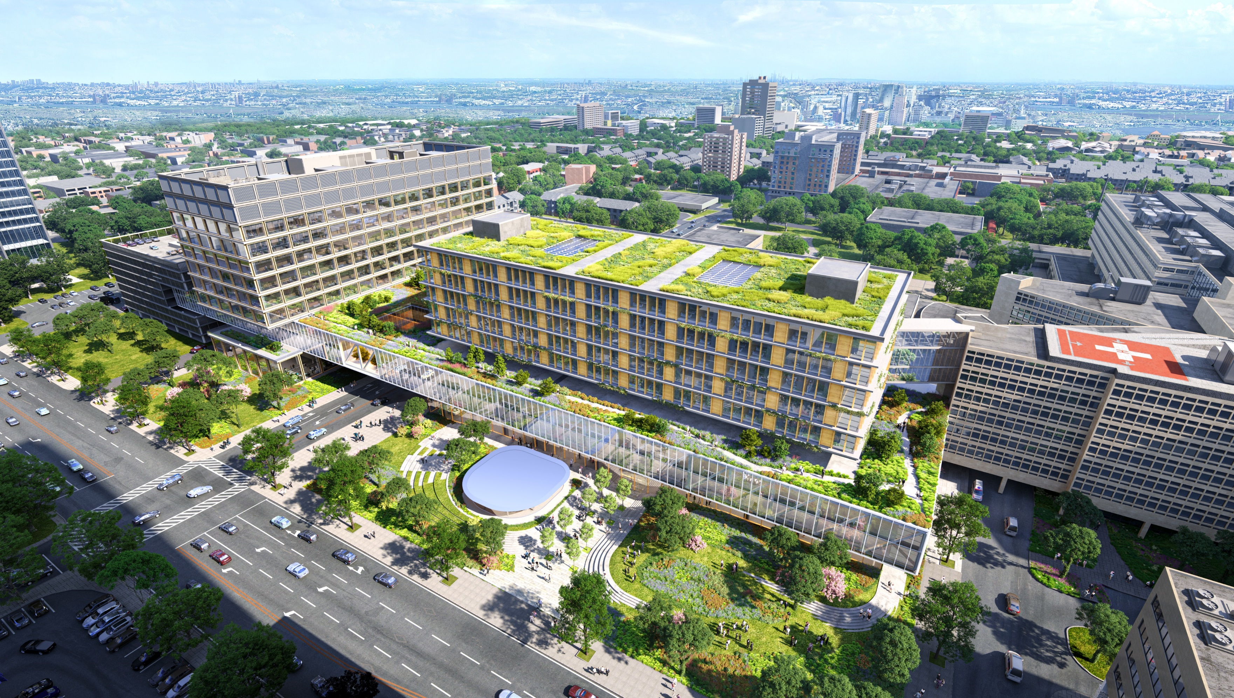
^{Safe, Accessible Parking}
^{Transparency & Visibility}
^{Restorative Space}
^{Retail Opportunity}
^{Community Space}
^{Green Space}

Slide 6
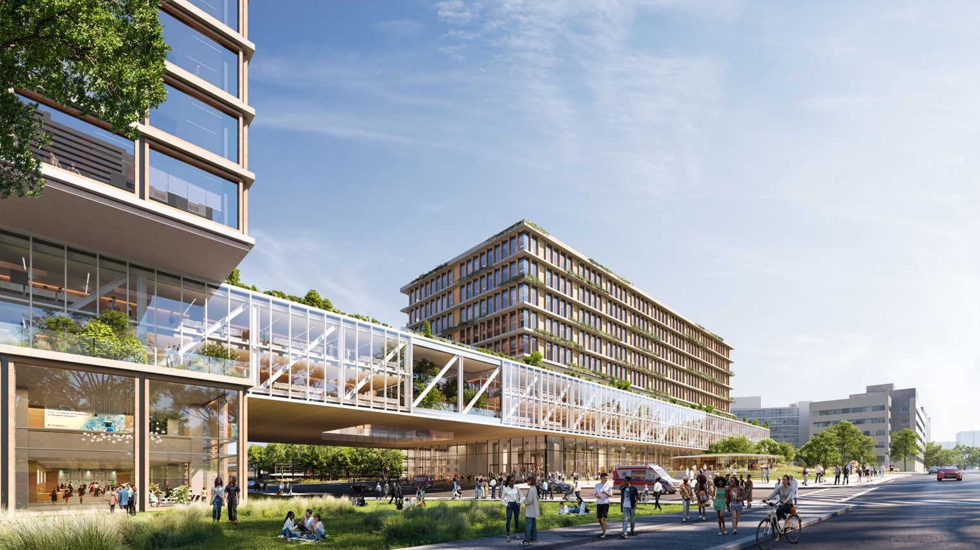
01 Process & Roadmap
02 Community Engagement
What We Heard
Your Vision. Your UH.
Your Voices in Design

Slide 7
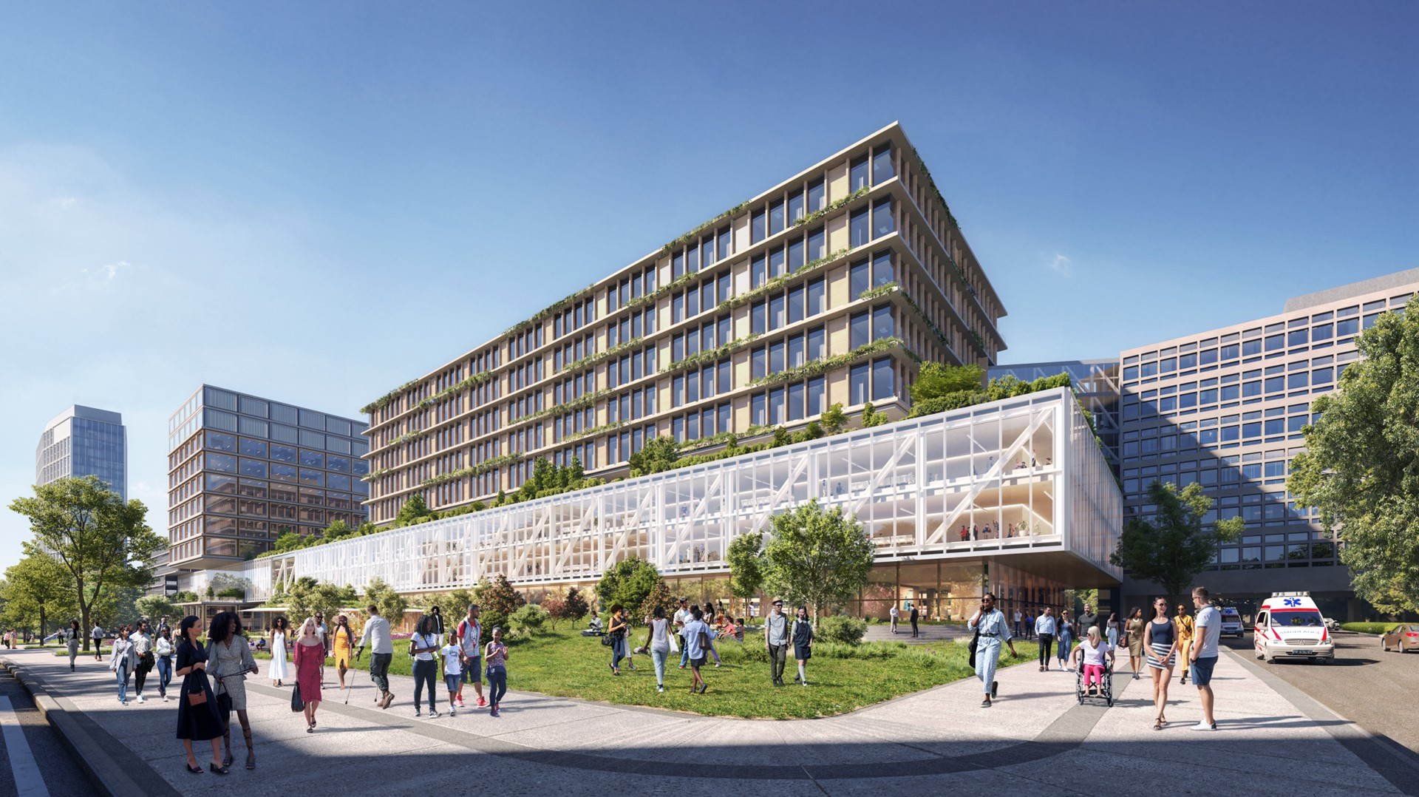
01 Process & Roadmap
02 Community Engagement
What We Heard
Your Vision. Your UH.
Your Voices in Design

Slide 8
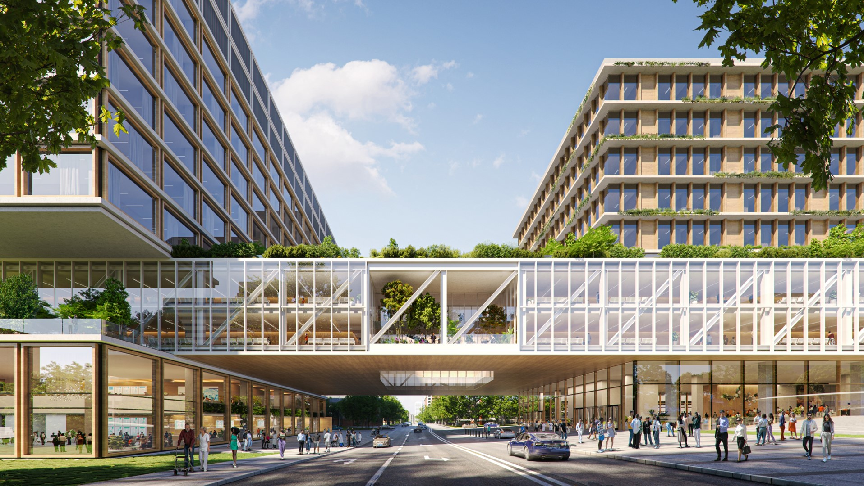
01 Process & Roadmap
02 Community Engagement
What We Heard
Your Vision. Your UH.
Your Voices in Design

Slide 9
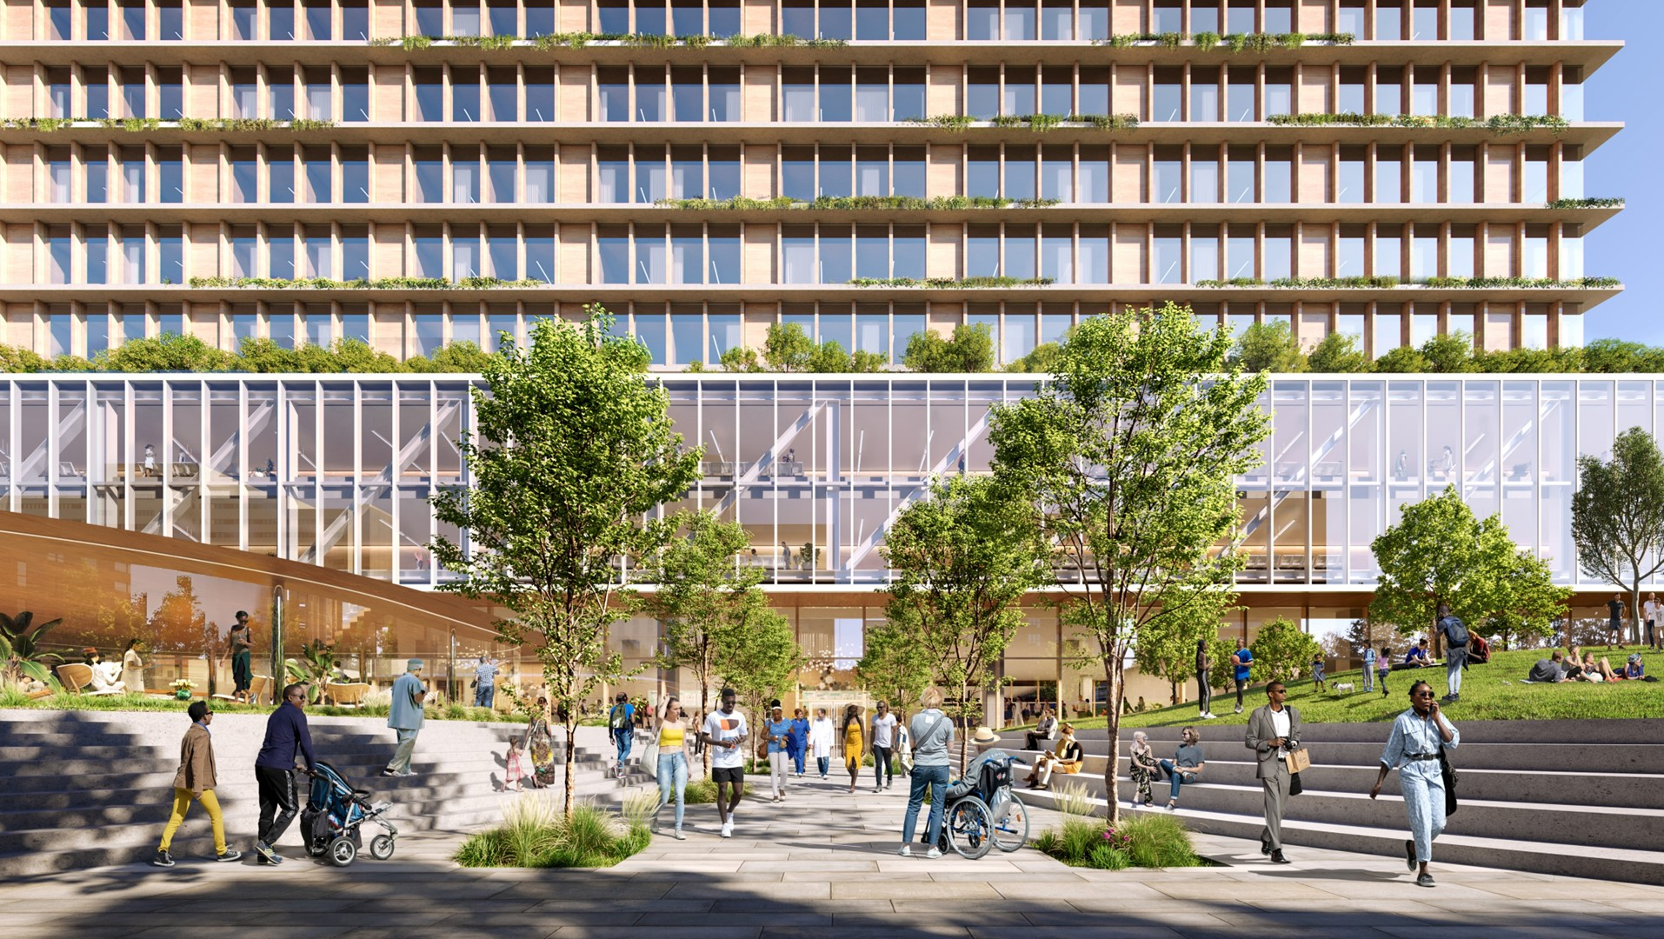
01 Process & Roadmap
02 Community Engagement
What We Heard
Your Vision. Your UH.
Your Voices in Design

Slide 10
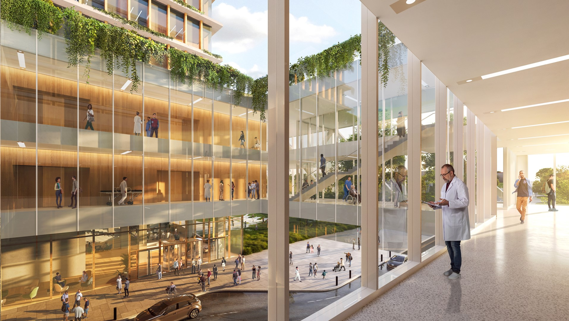
01 Process & Roadmap
02 Community Engagement
What We Heard
Your Vision. Your UH.
Your Voices in Design

Slide 11
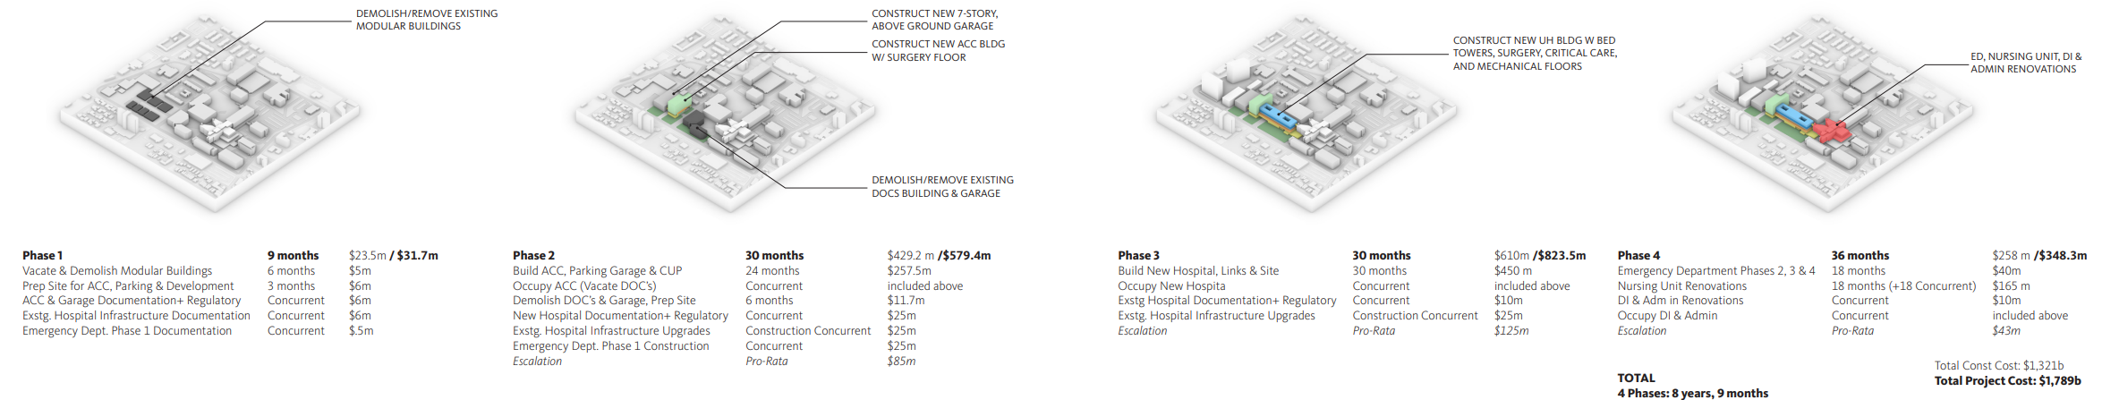
Campus Development Strategies | Draft Option
Mostly Enabling
Mostly Replace DOC, Parking Garage, Start ED Construction
Mostly Build New Hospital Building
Renovation of the Existing University Hospital
9 MONTHS
30 MONTHS
30 MONTHS
36 MONTHS
~ $610 MILLION
~ $1.2 BILLION
8 YEARS, 9 MONTHS
$1.80 BILLION PROJECT COST
UNIVERSITY HOSPITAL | GENSLER
Draft: Advisory, Consultative and Deliberative

