Slide 1

Environment of Care (EOC)
University Hospital
Orientation, Training & Education

Slide 2
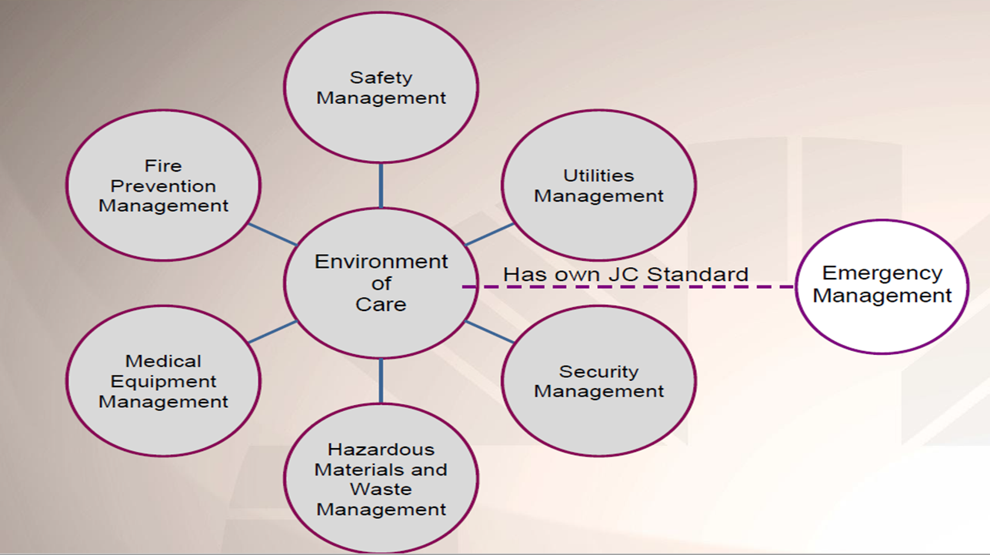
Environment of Care (E.O.C)

Slide 3

Safety Management Overview
Managing the safety of our Staff, Patients, Volunteers, and Visitors within our facility.
Inside and Outside (Physical Hazards/grounds)
Injury Prevention
Product Recalls
Environment of Care Rounds

Slide 4
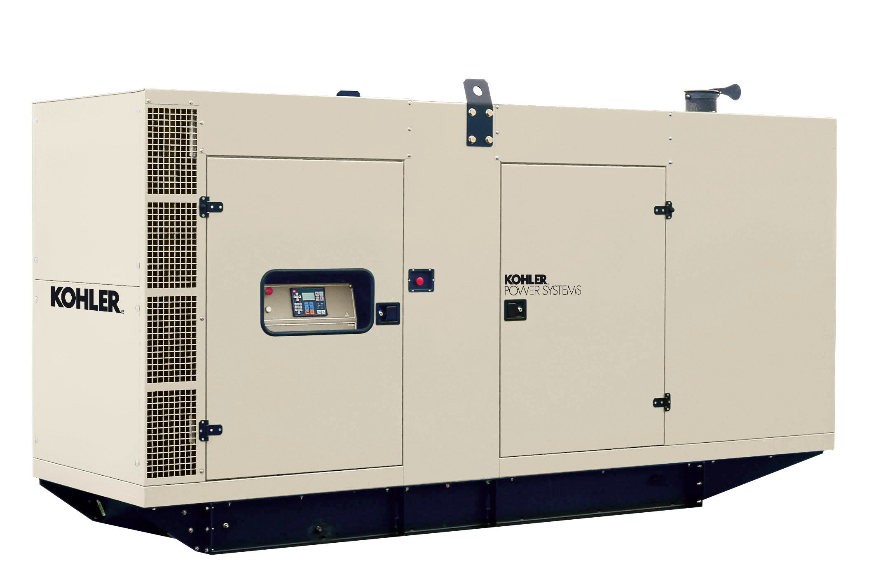
Utilities Management Overview
Managing the effective, safe, and reliable operation of utility systems
Electrical (generators)
Heating, Ventilation, & Air Conditioning (HVAC)
Plumbing Systems
Medical Gas System
Boilers/ Heat Exchanges
Elevators
Fire Prevention, Detection and Suppression Systems

Slide 5

Security Management Overview
Process implemented to effectively manage the security of our Staff, Patients, and Visitors within our facility
Security Presence
Security Cameras
Evolv System
Access Control and Egress Doors
Infant/Child Abduction System (Code Amber)
Violence Prevention (e.g., Workplace Violence Identification and Prevention)
ID Badges / Visitor’s pass
Panic Buttons

Slide 6

Security Management Overview – (continued)
Panic Buttons
You need to know the locations in your area……
Signal will go directly to Security Command Center.
Security Officer will be immediately notified and respond for assistance.

Slide 7
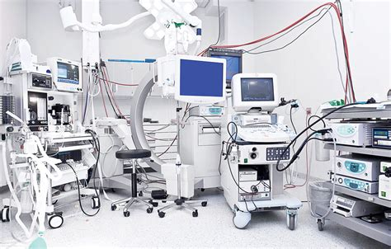
Medical Equipment Overview
Process to ensure the effective, safe, and reliable operation of Patient Care Equipment
Department of Clinical Engineering assures:
Inventory
Preventive Maintenance
Inspections
Recalls

Slide 8
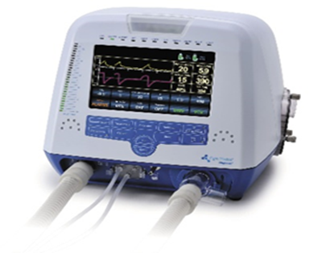
Medical Equipment Overview – (continued)
Be sure to review procedures for the proper use of equipment
Immediately take any faulty equipment out of service
Tag it (Defective – Do Not Use) and notify your supervisor.
Know where the tags are on your specific unit.

Slide 9

Fire Safety Overview
In the event of a fire or smoke condition in the hospital:
Use Emergency call number 1-1-1
Notify the others of the fire by announcing:
CODE RED, CODE RED, CODE RED do not shout Fire
Remember RACE
R = Rescue (anyone in immediate danger)
A = Alarm (pull the alarm)
C = Contain (close all doors)
E = Extinguish or Evacuate
TEAMWORK is essential!

Slide 10

Fire Safety Overview – (continued)
Listen for the “Code Red” announcement to identify the location of the fire alarm
Fire & Smoke Doors will release on:
  the floor, floor above, & floor below of the activation
  Patient unit doors must be closed manually.

Slide 11

Fire Safety Overview – (continued)
Remain alert and wait for further instructions.
Do Not Use Elevators
Do Not Evacuate, unless given direction by the Fire Department
You may resume your duties once the “Code Red- All Clear” has been announced 3 times over the P.A. System

Slide 12
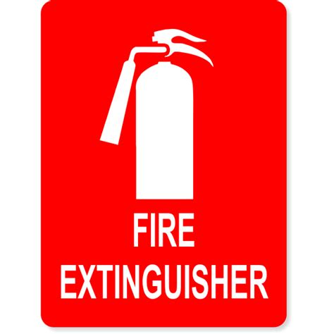
Fire Extinguishers
In the main hospital we have the following types:
Class A: Involves the burning of ordinary combustibles
(e.g., wood, paper, cloth)
Class B: Involves the burning of flammable liquids
(e.g., gasoline, oil, paint)
Class C: Involves energized electrical equipment
(e.g., appliances, fans, motors)
Class ABC: Can extinguish class A,B, and C fire
Class K: Involves cooking oils and fats (Kitchen)

Slide 13

Fire Extinguishers – (continued)
To use a fire extinguisher, remember PASS:
P = Pull the pin between the two handles
A = Aim the nozzle at the base of the fire
S = Squeeze the handles together
S = Sweep the nozzle from side to side

Slide 14
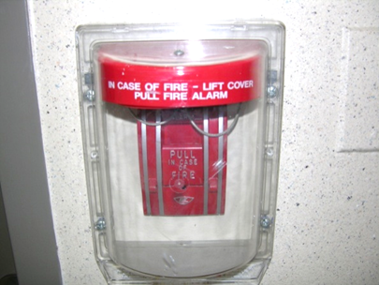
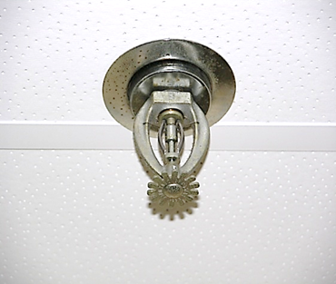
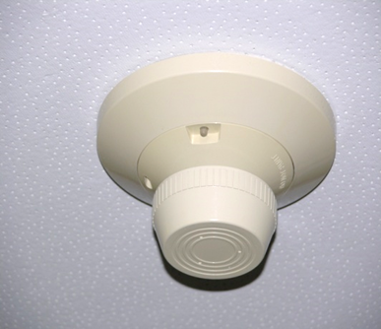
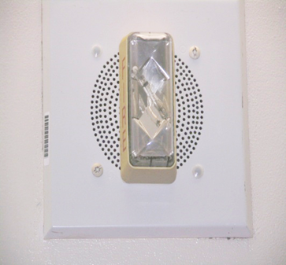
Fire Alarm Devices
Pull Stations, Sprinkler Heads, Smoke Detectors & Speakers/Strobes

Slide 15
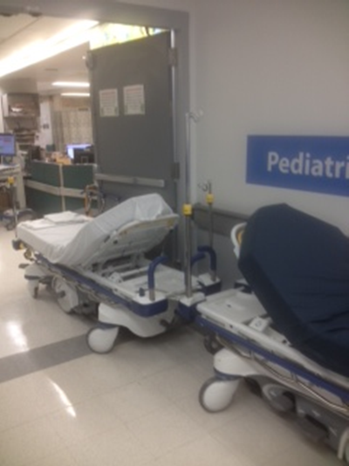
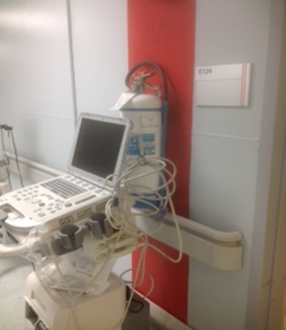
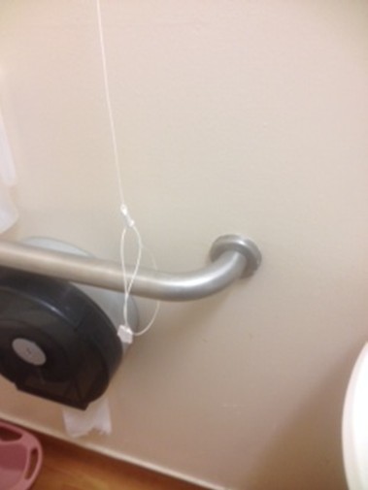
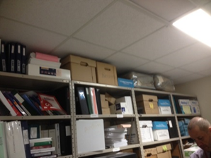

Safety Issues
#2 - Blocked Fire Extinguisher
#3 - Tied Nurse Call Cord
#1 - Blocked Fire Doors
#5 - Using door wedge
#4 - 18” Rule

Slide 16
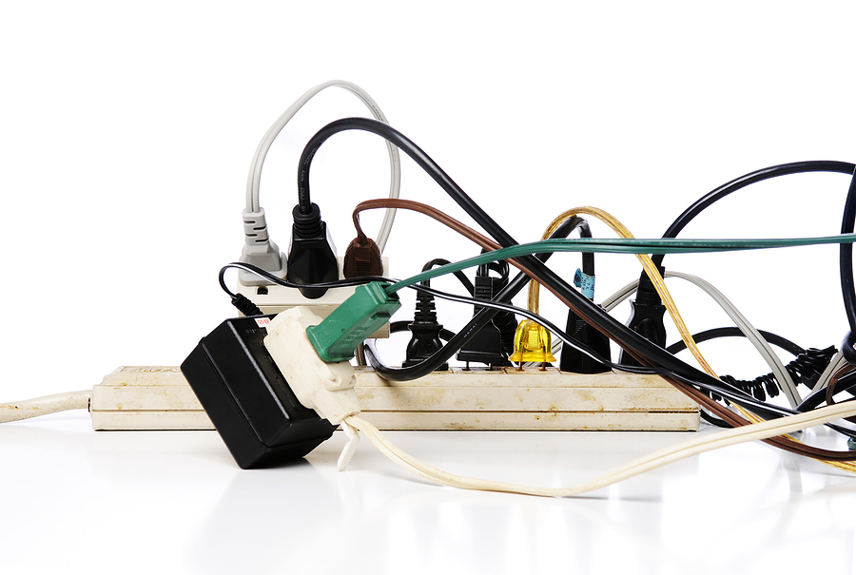
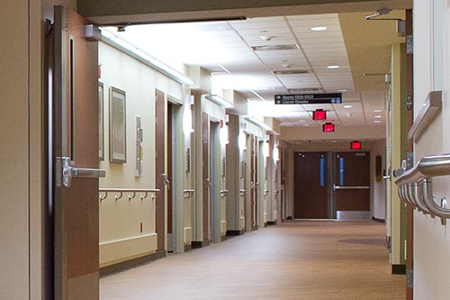
Safety Tips
Do not prop doors open
Keep hallways clear
Do not use personal cooking devices such as toasters & small oven
Do not overload electrical circuits
Extension cords are not permitted in the hospital, unless they are UL listed and approved by Physical Plant
Smoking is NOT PERMITTED

Slide 17

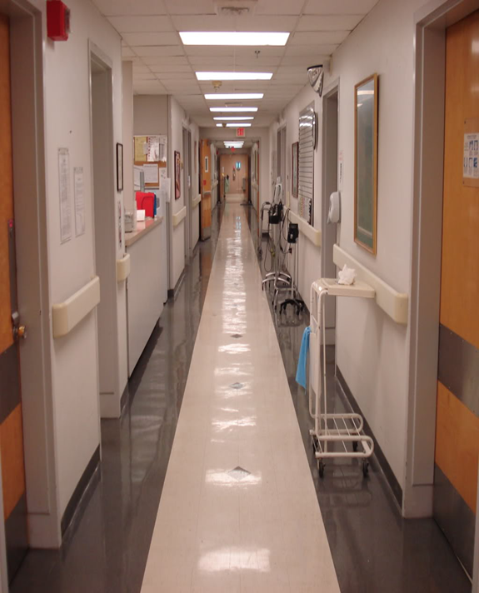

Know your environment……
Location of:
Fire extinguishers
Stairwells
Pull Stations
Medical Gas Valves
Panic Buttons
Exits

Slide 18
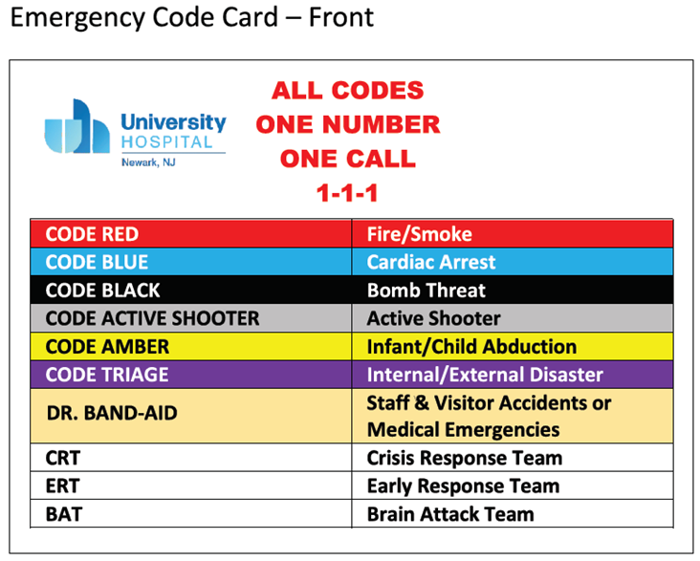
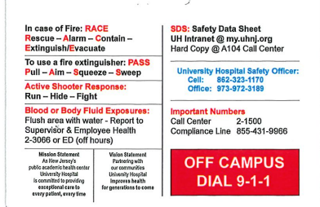
UH – Emergency Code Card
Back

Slide 19
University Hospital Call Center
Call 2-1500
Use Requested Services:
Environmental Service Issues
Work Request Orders
Clinical Engineering
Electrical Services
Maintenance Services
Patient Transport
Life Safety Issues
EOHSS – (Environmental & Occupational Health & Safety Services)
Television Request
Scrub Machine & Linen Issues

Slide 20
Contact Information
Donna Zeuner, RN, BSN, MHA
Environment of Care Manager
Hospital Safety Officer
Hospital Support Services
Room A – 220
Extension 2 – 3358
Cell # (973)943-1177

