Slide 1

New Employee Orientation Overview
Includes:
  New Employee Orientation Booklet
  Employee Handbook
You will receive these booklets on Day 2

Slide 2
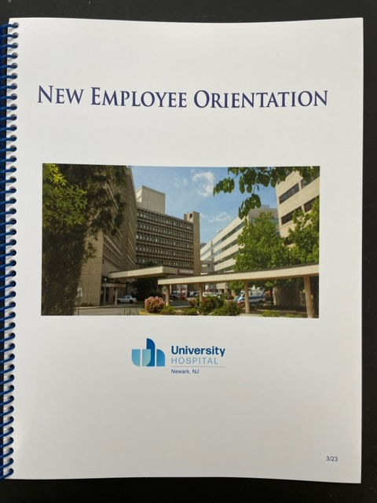

Slide 3
Dear University Hospital Employees:
Welcome to University Hospital. I am delighted to have you on our team of talented employees, all of whom are dedicated to putting our patients first.
The New Jersey Medical and Health Sciences Education Restructuring Act established our hospital as a separate, standalone entity and an instrumentality of the State on
July 1, 2013. This transition continues to give all our valued employees opportunities to advance our mission of improving the quality of life for all those we touch through excellence in patient care, education, research, and community service.
We look forward to having you on board as we work to shape our future. I am confident we have the potential to become one of the leading academic medical centers in the country.
I believe you will find much satisfaction in contributing to our important mission, and I look forward to your success at University Hospital.
Sincerely,
Chief Human Resources Officer

Slide 4
Our Mission
As New Jersey’s public academic health center University Hospital is committed to providing exceptional care to every patient, every time
Our Vision
Partnering with our communities, University Hospital improves health for generations to come

Slide 6
Fast Facts 2022
519 | Beds
3,731 | Full-time Employees
17,000 | Admissions
1,200 | Births
75,000 | Emergency department visits
107,774 | Emergency Medical Services responses
230,000 | Clinic outpatient visits

Slide 7
University Hospital Key Contacts
Operator (973)972-6000
Admitting (973) 972-4044
Cafeteria Talking Menu (973) 972-4023
Chaplaincy Services (973)972-1943
Emergency Department (973) 972-5123
Environmental Health & Safety (HAZMAT) (973) 972-3411
Ethics and Compliance (973) 973-6274
Human Resources (973) 972-3252
HR – Benefits (973)972-3925
HR – Employment (973)972-3698
HR – Labor Relations/Workplace Diversity (973)972-7087
HR - Learning and Organizational Development (973)972-9391
IST Helpdesk 2-1666
Medical Records (973) 972-5608
Nursing Office (973) 972-5677
Outpatient Appointments (973) 972-9000
Patient Relations (973) 972-6410
Patient Safety (973) 972-6373
Payroll Manager (973)972-1200
Physician Relations (973) 972-1238
Pre-Admission Testing (973) 972-2999
Public Affairs (973)972-6273
Public Safety Allied Universal Security UH (973)972-5000/Rutgers (973) 972-4490 or 222
Social Services (973) 972-5842
Web Portal www.my.uhnj.org
Work Orders and Support Services Call Center (973) 972-150

Slide 8
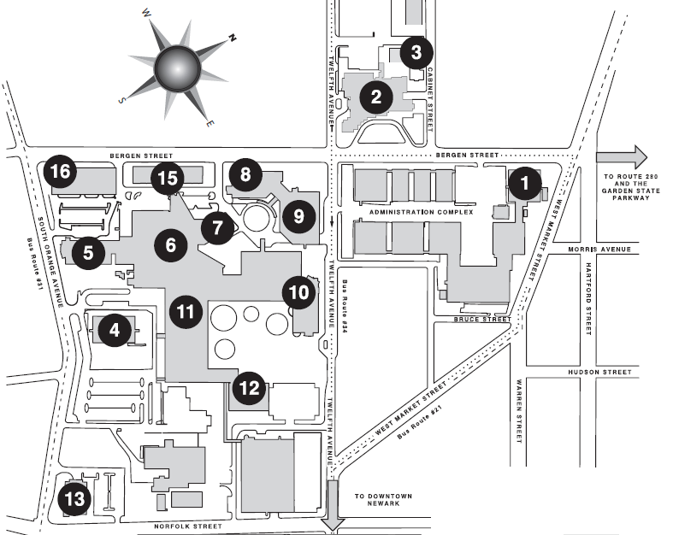
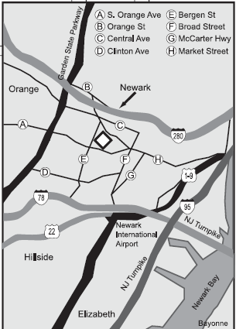
University Hospital Campus Map
1 - (ADMC) Admin. Complex
2 - (SSB) Stanley S. Bergen Jr. Bldg.
3 - KinderCare
4 - (UBHC) University Behavioral Health Care
5 - New Jersey Cancer Center
6 – (UH) University Hospital
7 - Stone Center
8 - (DOC) Doctors Office Center
9 - DOC Parking Garage
10 - NJ Dental School
11 - (MSB) Medical Science Bldg.
12 - George H. Smith Library
13 - Institute of Forensic Sciences
14 – (ICPH) Int’l Center for Public Health
15 - (ACC) Ambulatory Care Center
16 – Parking Deck
Rutgers Bus routes:
Penn Station (Local and Express) and Campus Connect
#21 Bus Route -------------------------------
#31 Bus Route -- - -- - -- - -- - -- - -- - -- -
#34 Bus Route ………………………………....

Slide 9


Slide 10
Employee Rights and Responsibilities
Personal Appearance
It is important that employees representing University Hospital present a professional impression to the public, patients and co-workers. Your personal appearance is the basis of such an impression and therefore appropriate clothing, good grooming, neatness and cleanliness are essential. You are expected to follow the Dress Code policy.
If you work in an area where uniforms are required, you must wear your full uniform at all times and it must be neat and clean. Also, be sure that your accessories, such as scarves, belts and jewelry do not present a safety hazard around equipment and office machinery.
Your employee I.D. badge is considered a part of your attire/uniform and must be worn at all times conspicuously with your name in full view when on duty or when present on University Hospital property.

Slide 11
Solicitations and Distribution
In the interest of maintaining the best possible environment for the furtherance of our mission, solicitation for contributions by employees is prohibited unless it is related to Hospital sponsored or approved activity. Distribution of literature by Hospital employees, outside vendors or members of the public is prohibited. Unauthorized solicitation and distribution must be reported to the Chief Human Resources Officer. If you have any questions about this policy contact your Supervisor or the Human Resources Department.

Slide 12
Personal Phone Calls and Mail
Personal Computers, Email, Internet and Social Media
Many employees have been provided with personal computers (PC’s). Sufficient cautionary
measures should be taken in conjunction with IST and Public Safety to secure these pieces of
University Hospital equipment.
Many Hospital PCs have been provided access to the Internet and to various E-Mail networks. The purpose is to enhance each user’s ability to perform his/her job. Accessing the Internet for personal reasons in lieu of performing work during business hours is prohibited. In addition, employees with Internet and e-mail access must be mindful of what messages are communicated to fellow staff through this particular medium, as well as through conventional media. Moreover, downloading, or even accessing, web sites which may be considered sexual in nature is clearly an unauthorized use of the electronic tools which have been provided by the Hospital.
Any misuse of the electronic media may subject the individual to disciplinary action, up to and
including termination. Please note University Hospital reserves its right to monitor PC usage.
You are expected to follow the Use of Social Media policy.

Slide 13
Attendance
Every employee of University Hospital has been assigned specific tasks and specified hours during which these tasks are to be performed. Therefore, regular attendance and punctuality are essential to providing high quality patient care and efficient dependable service to outside agencies and the public.
If you are going to be unavoidably detained or if you will not be able to report for work, notify your Supervisor as early as you can, in accordance with departmental and Hospital policy. If you will be out ill, you must keep your Supervisor informed each day, and indicate your approximate date of return to work. If you fail to call your Supervisor and notify him/her of an unscheduled absence, you will be considered absent without leave and subject to disciplinary action under the Hospital’s Attendance Control Policy.
If you are serving a probationary period, failure to maintain satisfactory attendance can result in failure of probation and termination of your employment. Every employee has an obligation to keep absences, especially unscheduled ones, and lateness to an absolute minimum.
Unscheduled absences and lateness place a burden on your Department, especially your Supervisor and co-workers. You are expected, throughout your employment with the Hospital, to comply with our attendance standards. Failure to comply will result in disciplinary action under the Hospital’s Attendance Control Policy.

Slide 14
Emergency Curtailment of Operations
Severe weather condition(s) such as a snowstorm, ice storm, flooding, hurricane, or other catastrophic events may threaten the continuation of some programs and services provided by University Hospital and necessitate the declaration of an “Emergency Curtailment of Operations”. However, operations such as inpatient patient care services require the continuation of such services no matter what weather/emergency conditions occur.
Announcements of closing by any federal, state and/or local governmental agency do not pertain to University Hospital. The Hospital makes its own determination as to whether to declare an “Emergency Curtailment of Operations”. Your Supervisor will advise you with regard to your status and obligations should such be declared.

Slide 15
Employee Conduct and Performance
Listed below are certain activities which are strictly prohibited. Employees who engage in these or other prohibited activities may be disciplined and could be subject to termination even for the first offense. This list is not intended to cover every possible situation that may arise, but is designed to give you a basic understanding of common types of unacceptable conduct or performance
Falsification of employment application, related documents or other University Hospital records.
Any unauthorized employment while on leave of absence.
Clocking in or reporting time of arrival or time of departure for another employee, clocking in for another employee, or requesting another employee to record time other than his/her own.
Theft of Time.
Frequent tardiness or absenteeism or unauthorized absence from workstation during work hours.
Loafing or sleeping on the job during working hours.
Insubordination (refusal to carry out orders, instructions or an assignment).
Failure to Follow a Directive.
Using racial, religious or sexual epithets.
Gambling on University Hospital premises. and more as noted on page 26

Slide 16
Fitness for Duty
All University Hospital employees are expected to report to work ready and able to perform their
job responsibilities. You must be free of the influence of any intoxicant, including but not limited
to alcohol or any controlled substance. During work hours you can neither possess nor consume
any intoxicant, illegally obtained controlled substance or illegal substance. Failure to adhere to
any of the above will result in disciplinary action or termination of employment. An employee
who has a physical and/or mental impairment, which could adversely affect the ability to perform
job duties, shall report this to the immediate Supervisor. The impairment may be the result of
an illness, injury, emotional disorder, medication use or use of a chemical substance, including
alcohol and controlled substances.

Slide 17
Smoking
University Hospital is a smoke-free institution. Smoking by employees, students and visitors is prohibited in all Hospital facilities. In some entrance areas, receptacles are provided to dispose of cigarettes. The Hospital encourages employees to stop smoking at all times. However, if you are found to be smoking inside a Hospital facility, you will be subject to disciplinary action.

Slide 18
Outside Employment
When you accept a position as a full-time employee of University Hospital, you agree that your primary work obligation is to the Hospital. If you desire to work outside of working hours for another employer, you must notify the Hospital of such employment. Such outside employment must not present a conflict of interest, conflict in hours and must not diminish your capacity to fulfill your obligations to your primary employer - University Hospital. Failure to observe this policy with respect to outside employment will subject you to disciplinary action.

Slide 19
Notice of Resignation
If you decide to resign from your position with University Hospital, you should give a minimum of three (3) weeks’ notice. Individuals in management and executive positions are expected to give a minimum of four (4) weeks’ notice. Upon resignation or separation from the Hospital, it is required that all Hospital property be returned to either your immediate Supervisor or Human Resources (i.e. - keys, parking hang tag, identification cards, etc.). You may be requested by Human Resources to participate in an exit interview to be conducted by your HR Generalist.

Slide 20
Personal Data
University Hospital offers web services for all active employees to access personal, confidential Payroll and Human Resources information. Banner Self-Service provides you the ability to view and update personal information such as address, phone numbers, emergency contacts and W28 4 elections. All Hospital employees are required to provide up-to-date personal data to the Human Resources Office. Therefore, if your marital status changes or you have any additional dependents, you should let the Human Resources Office know as soon as possible. This will ensure correct insurance coverage and receipt of official communications sent to your home (including W-2 forms).

Slide 21
Union Representation
Many Hospital employees are covered by collective negotiations agreements. Listed below, for your information, are the unions which represent different groups. Each union is the exclusive legal agent for the employees in each group and engages in collective negotiations with University Hospital on behalf of its members.
International Brotherhood of Teamsters, Local 97 for clerical, paraprofessional, service and
technical staff.
Hospital Professional and Allied Employees (HPAE 5089) for professional nurses
Hospital Professional and Allied Employees (HPAE 5094) for professional staff
Operating Engineers, Local 68 for skilled trades International Association of EMTs & Paramedics for EMS Supervisors Committee of Interns and Residents for Interns, Residents and Fellows
Communications Workers of America, Local 1031 for non-nursing, non-EMS, Supervisory staff
If you are interested in becoming a Union member, please contact the Union which represents
employees in your job title.

Slide 22
Non-Discrimination, Harassment and Other Inappropriate Workplace Conduct
Working and Learning Environment
Consensual Relationships
Pages 28 and 29

Slide 23
Compliance
Employee Conduct
Deficit Reduction Act
Whistleblower Protections
Enforcement and Whistleblower Protections at University Hospital
Pages 29-38

Slide 24
Your Future at University Hospital
Job Postings
Promotions and Transfers
Performance Evaluations
Employee Development

Slide 25
ACKNOWLEDGMENT OF RECEIPT
I hereby acknowledge receipt of University Hospital’s Employee Handbook, and further acknowledge that it is my responsibility to read and understand its contents. I understand this handbook is intended as a general source of information and nothing contained in this handbook constitutes a contractual agreement between me and the Hospital. I further understand that, University Hospital reserves the right to change, rescind or add to its policies, benefits and/or
practices at any time without prior notice.
(Please Print) Name:_____________________________________
Employee I.D. #: A______________________________
Employee Signature: _____________________________
Supervisor/HR Representative: ___________________________
Date: ___________________

