Slide 1

Patient Safety
2023

Slide 2
Our Mission
As New Jersey’s public academic health center University Hospital is committed to providing exceptional care to every patient, every time
Our Vision
Partnering with our communities, University Hospital improves health for generations to come

Slide 3

The Patient Safety Team
Maria Brennan, DNP, RN, CPHQ
Chief Nursing Officer, ext. 2-1786
Bill Holubek, MD, MPH, FACMT, FACEP
Chief Medical Officer & Patient Safety Officer, ext. 2-0440
Toni Armada-Oanes, MSN, CPHQ, CPPS
Executive Director Quality & Patient Safety, ext. 2-2405
Inna Mesh, MSN, NEA-BC
Director Patient Safety & Clinical Risk, ext. 2-9317
Patricia Rondan-Mann, MPA
QAPI Coordinator, ext. 2-4114
Michelle Morales, MSN, RN-BC, NPD-BC, C-EFM
QAPI Coordinator, ext. 2-6426
…and YOU!

Slide 4

National Data: Patient Harm
From Leapfrog Regarding Patient Safety:
As many as 440,000 people die every year from hospital errors, injuries, accidents, and infections
Every year, 1 out of every 25 patients develops an infection while in the hospital—an infection that didn’t have to happen.
A Medicare patient has a 1 in 4 chance of experiencing injury, harm or death when admitted to a hospital
Today alone, more than 1000 people will die because of a preventable hospital error

Slide 5
National Data: Employee Harm

Slide 6
How do we keep ourselves and our patients safe?

Slide 7
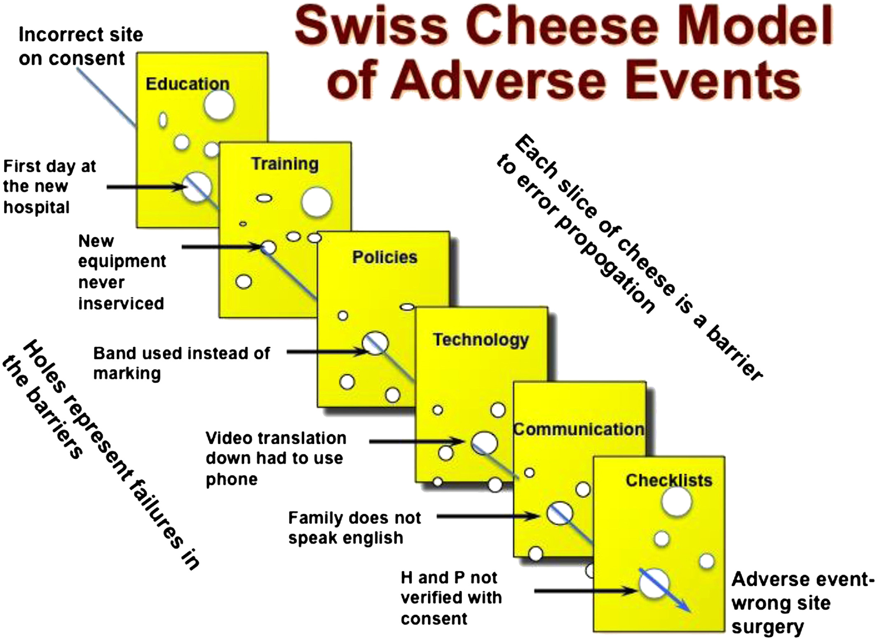
"Adverse event" means an event that is a negative consequence of care that results in unintended injury or illness, which may or may not have been preventable.

Slide 8

Risk is everywhere. Be preoccupied with failure!
High Reliability Organizations (HROs) are preoccupied with failure and work to find and acknowledge small or emerging issues because they see them as clues to additional failures elsewhere in the system.
Being preoccupied with failure means that you are always looking for and anticipating risks and potential problems.
Ask Yourself:
How will the next patient be harmed today?
Recognize that failure is normal, but accidents can be avoided.
There can be unexpected failure, even in common activities.
Expect failure to happen AND prepare for it.

Slide 9
How to Submit a
Safety Intelligence (SI)
Event Report
Enter an SI report whenever an unexpected occurrence or variation in care occurs when:
harm has reached the patient; or
harm may reach the patient.

Slide 10

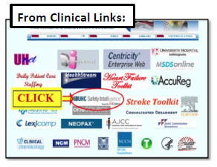
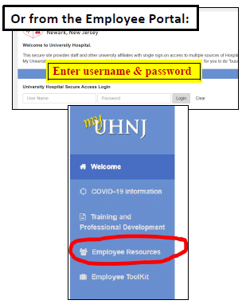
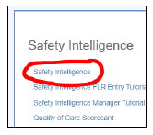
How to Enter a Safety Intelligence (SI) Report
Enter a factual account of what happened, avoid accusations.
SI is not for escalation- follow usual processes to escalate.
Remember- we use the information reported in these events to LEARN and IMPROVE.

Slide 11

The more we report, the more we can learn and improve.

Slide 12
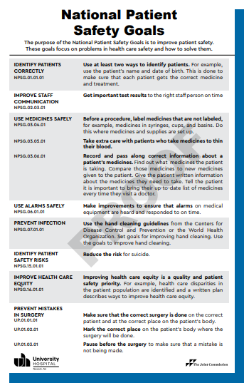

National Patient Safety Goals (NPSG)
The
Joint
Commission
(TJC)
The Joint Commission (TJC) established the National Patient Safety Goals (NPSGs) to help address specific areas of concern related to patient safety.
The goals are based on real events.
Look for this poster

Slide 13
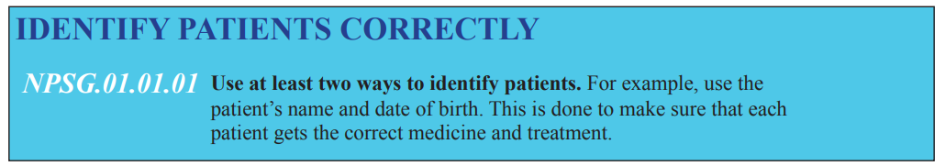



Always
SPEAK WITH THE PATIENT to confirm their information.
Use a language interpreter if the patient’s primary language is not English.
ASK the patient their name.
DO NOT state the patient’s name and ask for confirmation:
“Please tell me your name.”
NOT “Mr. John Smith?”
UH Policy #831-200-301, Patient Identification
Inpatient: Confirm Name & Medical Record Number (MRN)
Outpatient: Confirm Name & Date of Birth

Slide 14



UH Policy: Critical Value Reporting
Find the provider on-call schedule on AMiON at:
amion.com
Password:
uhnj

Slide 15
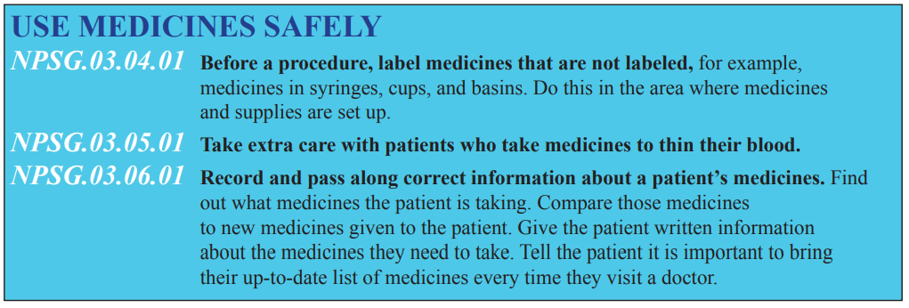

Access medications one patient at a time and then administer to that patient, prior to accessing and administering medications to another patient.
Identify the patient using at least two hospital approved identifiers (name & date of birth or medical record number).
Verify the medication, dosage strength, route schedule.

Slide 16
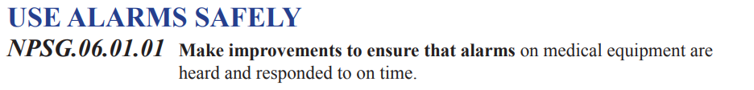
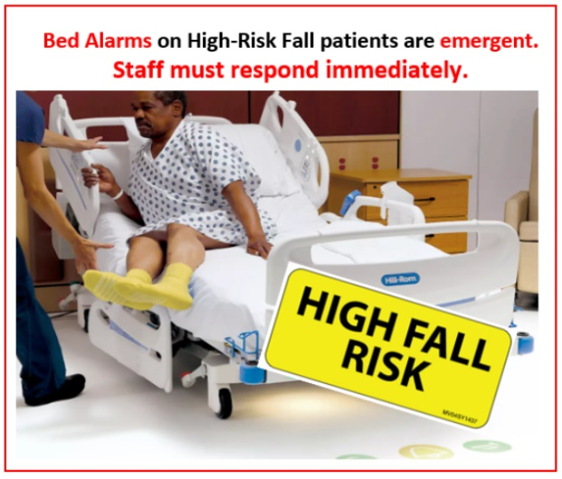
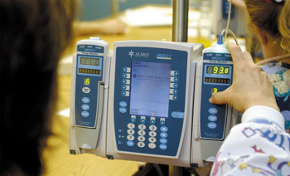
Don’t ignore alarms.
Don’t instruct family members/visitors on how to silence alarms.

Slide 17
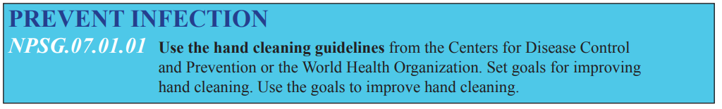


Always clean your hands before putting on gloves.

Slide 18
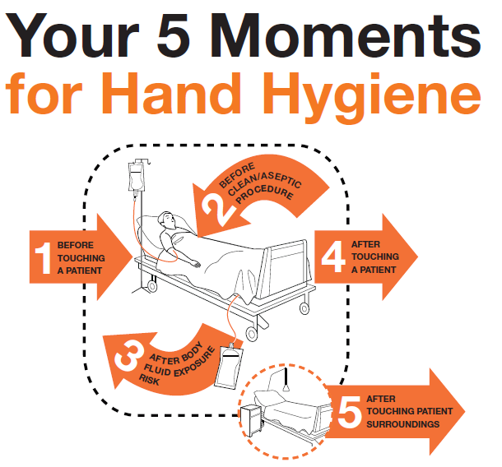
For
Inpatient
Care

Slide 19
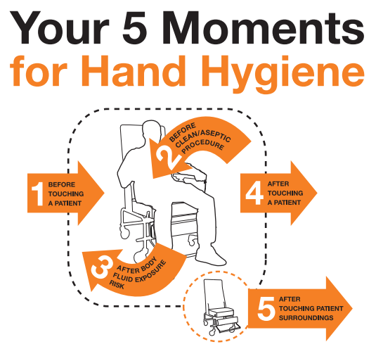
For
Outpatient
Care

Slide 20


UH Policy: Suicidal / Homicidal Patient Risk Assessment
UH Policy: Patient Observation / Safety Watch
Assess for risk of suicide upon admission
For INPATIENTS: For patients without a behavioral health diagnosis, reassessment for risk of suicide will be performed with change in the patient’s behavior indicative of suicidal ideation, or if the patient reports suicidal ideation during the course of treatment.
For OUTPATIENTS: Patients who verbalize intent for suicidal or homicidal behaviors will be immediately referred to the RN or Provider for additional assessment and intervention.

Slide 21
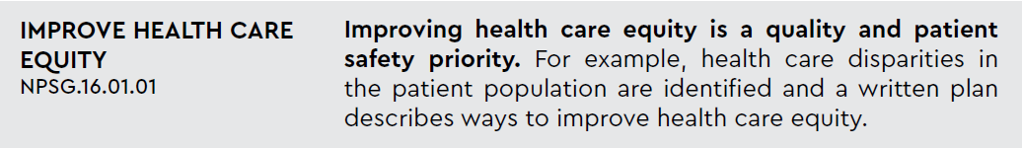

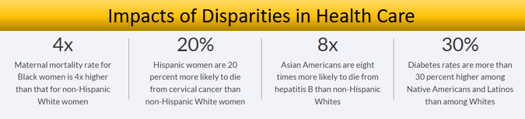
What is Health Equity?
“Health Equity is achieved when every person has the opportunity to attain his or her full health potential and no one is disadvantaged from achieving this potential because of social position or other socially determined circumstances. Health inequities are reflected in differences in length of life; quality of life; rates of disease, disability and death; severity of disease; and access to treatment.”
(Centers for Disease Control and Prevention, 2020)

Slide 22
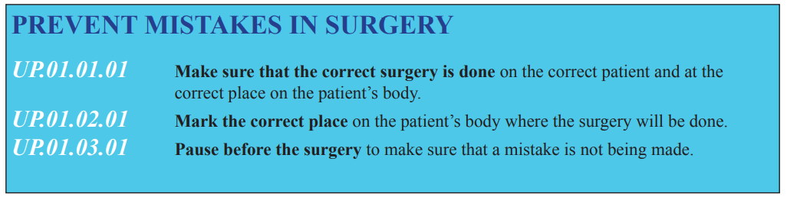

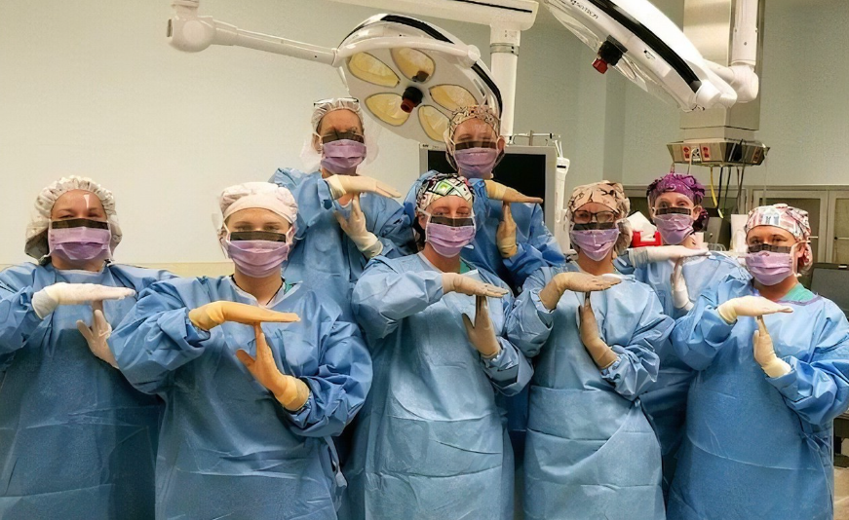
UH Policy: Verification of Correct Patient, Correct Procedure and Correct Site/Side for Invasive or Surgical Procedures
UH Policy: Invasive Procedures Applies to procedures performed by the medical staff of UH;
for use in all licensed locations that are part of University Hospital.

Slide 23

Your Role in Patient Safety

Slide 24

In a culture of safety, people are not merely encouraged to work toward change; they take action when it is needed. (IHI 2022)
A Culture of Safety…
Creates an environment of empowerment amongst staff to have their voices heard
Provides opportunities to identify human and system errors proactively
Improves Patient Outcomes

Slide 25
Culture of Safety Characteristics
Just
Culture
Encourages, rewards individuals for providing safety-related information
Establishes clear lines between human error, at risk, and reckless behaviors
Reporting Culture
Encourages individuals to report their errors and near misses
Learning Culture
Promotes a willingness to learn from mistakes
Implements safety improvement processes/projects when a need is identified

Slide 26

What should YOU do to promote a Culture of Safety at University Hospital?
To promote a Culture of Safety:
Self report errors and near misses & Great Catches
Get involved in unit and organizational safety initiatives
Work as a team and collaborating with other departments
Proactively look for human and system risks
Make your voice known (e.g. Culture of Safety Survey)

Slide 27
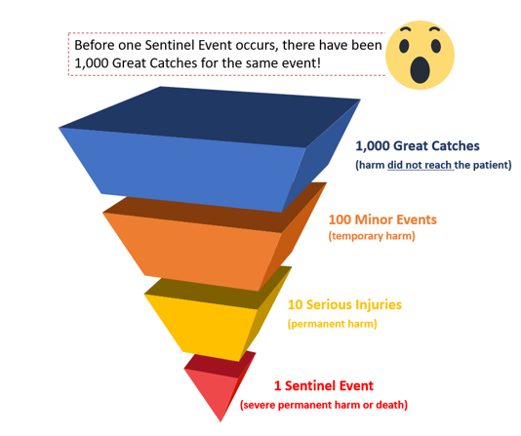
Report Great Catches
A Near Miss is…
  An event that did not reach the patient because of chance/timely intervention
A Great Catch is a Near Miss+
  An event that did not reach the patient because of chance/timely intervention
  AND
  Immediate action was taken to contain the situation and protect patient and/or staff
  AND
  Extra steps were taken to follow up
A Great Catch is an opportunity to prevent harm to patients in the future and a method for revealing process and system vulnerabilities.

Slide 28

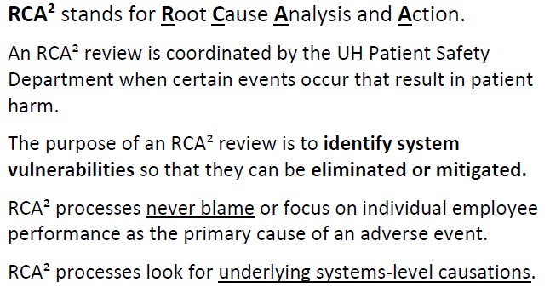
Participate in an RCA²

Slide 29
Your Role in the RCA² Process
As part of the RCA² process, you may be interviewed by a member of the RCA² team!
The purpose of the interview will be to gather information related to the event.
The team asks questions to identify systems or process issues– NEVER to blame individual staff.
You may be asked, “Why did the process not work for you in this situation?” so that the team can better understand and fix any problems with the existing process.
Your perspective is important and helps us to improve!

Slide 30
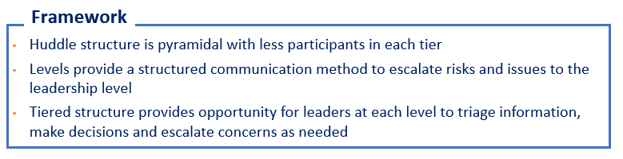
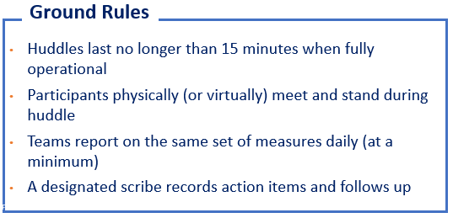
Participate in Tiered Huddles: To Reduce Risk and Harm
Executive
Level
(C-suite)
Tier III
Department Level
(Department Leadership)
Tier II
Frontline Level
(Frontline staff and managers)
Tier I

Slide 31
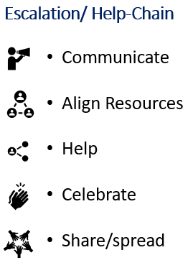
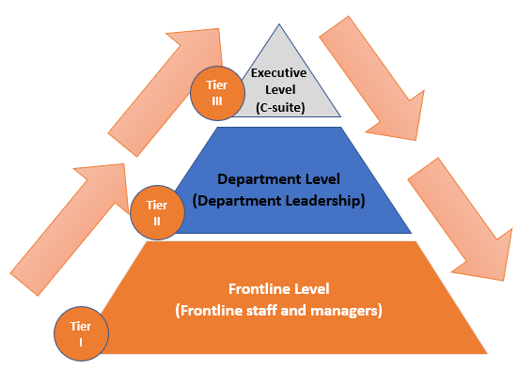
Tiered Huddles: Information flows up and down

Slide 32
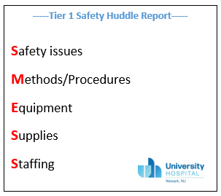

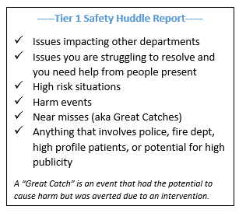
What should I report at my Safety Huddle?

Slide 33

What Can You Do
  Always introduce yourself to the team
  Clarify your role
  Read back/close the communication loop
  State the obvious to avoid assumptions
  Ask questions, check and clarify
  Use clear, plain language
Participate in team huddles and debriefings
Share information/ communicate
Assert yourself appropriately
Share lessons learned
Report Great Catches
Report safety events

Slide 34

Contact Us
Inna Mesh:
Office – (973) 972-9317
Cellphone – (973) 699-2561
Email – meshinn@uhnj.org
Patricia Rondan-Mann:
Office – (973) 972-4114
Email – rondanpd@uhnj.org
Michelle Morales:
Office – (973) 972-6426
Email – fedauzma@uhnj.org
Off Hours:
On-Call Cellphone – (973) 477-2113
On-Call Information located on AMiON

